Slide 1
Light-Weight Security and Data Provenance for Multi-Hop
Internet of Things
NITHIN BENNY
CLASS NO:43 S7 BTECH CSE
DEPT OF CSE , MACE KOTHAMANGALAM
October 10 , 2018

Slide 2
CONTENTS
Light-Weight Security and Data Provenance for Multi-Hop Internet of Things
Introduction
Existing system
System model
Node level
Server level
Data provenance
Results
Conclusion
DEPT OF CSE , MACE KOTHAMANGALAM

Slide 3
INTRODUCTION
Light-Weight Security and Data Provenance for Multi-Hop Internet of Things
Complex network of smart devices
Necessity of future
50 billion devices by 2020
Security focus
  Accuracy
  Provenance
DEPT OF CSE , MACE KOTHAMANGALAM

Slide 4
INTRODUCTION (contd..)
Light-Weight Security and Data Provenance for Multi-Hop Internet of Things
Data modifications
  Forging
  Tampering
Risk examples
  Medical health report
  Meter reading
  Transportation information
DEPT OF CSE , MACE KOTHAMANGALAM

Slide 5
EXISTING SYSTEM
Light-Weight Security and Data Provenance for Multi-Hop Internet of Things
IOT Nodes
  Large in number
  Small in size
  Mostly accessible
Limited energy source – Small battery size
Existing security algorithms
  High energy consumption
  High computational complexities
DEPT OF CSE , MACE KOTHAMANGALAM

Slide 6
EXISTING STYSTEM (contd..)
Light-Weight Security and Data Provenance for Multi-Hop Internet of Things
Battery life extension
3 possible approaches
  Use minimum security system
  Increase battery capacity
  Harvest energy from natural resources
Aim
  End-to-end content protection
  User authentication
DEPT OF CSE , MACE KOTHAMANGALAM

Slide 7
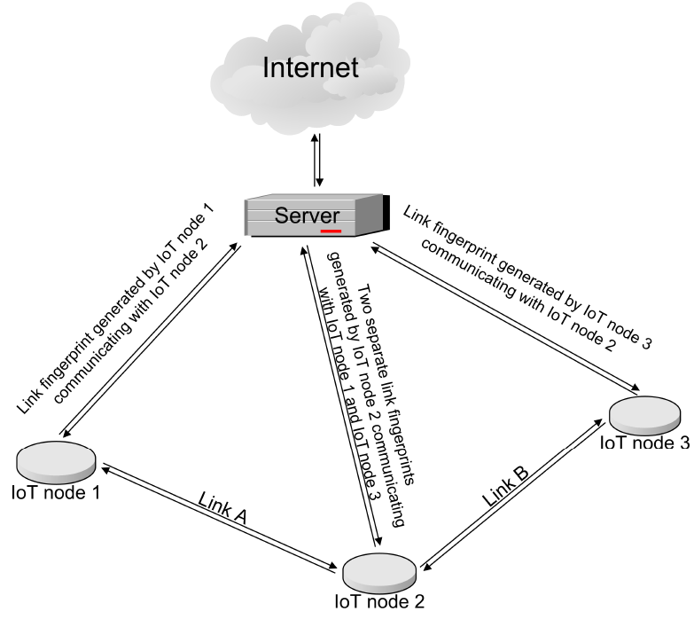
SYSTEM MODEL
Light-Weight Security and Data Provenance for Multi-Hop Internet of Things
Courtesy : https://ieeexplore.ieee.org/document/8401865
DEPT OF CSE , MACE KOTHAMANGALAM

Slide 8
NODE LEVEL
Light-Weight Security and Data Provenance for Multi-Hop Internet of Things
2 nodes communicate
Changing parameters
RSSI
  Measurement of power in received radio signal
Reason to choose
  Linear relation between variations in connected nodes
DEPT OF CSE , MACE KOTHAMANGALAM

Slide 9
NODE LEVEL (contd..)
Light-Weight Security and Data Provenance for Multi-Hop Internet of Things
MICAz motes
  RSSI values are taken in real time using MICAz motes
  Frequency : 2.4GHz
  Enabling low-power wireless sensor networks
  Outdoor range 75m to 100m
  Indoor range 20m to 30m
Simulations in MATLAB R2017a
DEPT OF CSE , MACE KOTHAMANGALAM

Slide 10
NODE LEVEL (contd..)
Light-Weight Security and Data Provenance for Multi-Hop Internet of Things
Considered scenarios
  No adversarial node
  Adversarial node in between two communicating nodes
  The packet is forged or tampered at any node
  A node is replaced by adversarial node
  Adversarial node sends data to server
DEPT OF CSE , MACE KOTHAMANGALAM

Slide 11
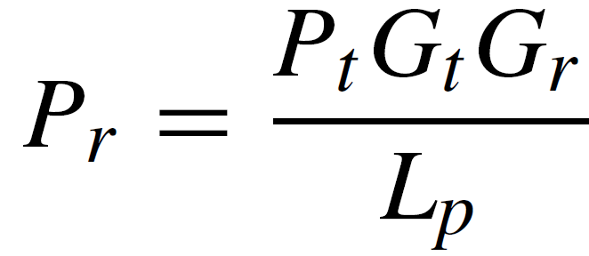
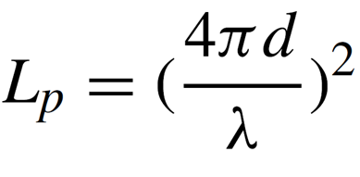
NODE LEVEL (contd..)
Light-Weight Security and Data Provenance for Multi-Hop Internet of Things
Recording time : 20s
RSSI calculation
  Friis transmission equation
Path loss
DEPT OF CSE , MACE KOTHAMANGALAM

Slide 12
NODE LEVEL (contd..)
Light-Weight Security and Data Provenance for Multi-Hop Internet of Things
MICAz motes wavelength : 416µm
Create bandwidth
RSSI value range here : -48dBm to 20dBm
Add gain of 50 to make all values positive
DEPT OF CSE , MACE KOTHAMANGALAM

Slide 13
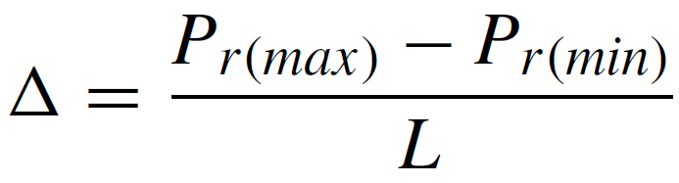
NODE LEVEL (contd..)
Light-Weight Security and Data Provenance for Multi-Hop Internet of Things
Divide the full bandwidth into L zones
Each of height Δ
Midpoint assigned
DEPT OF CSE , MACE KOTHAMANGALAM

Slide 14
NODE LEVEL (contd..)
Light-Weight Security and Data Provenance for Multi-Hop Internet of Things
Samples approximated
Mid value : Link fingerprint
  Conversion from decimal to 8 bit binary
Secret key for each node
  8-bit key
  Known only to node and server
DEPT OF CSE , MACE KOTHAMANGALAM

Slide 15
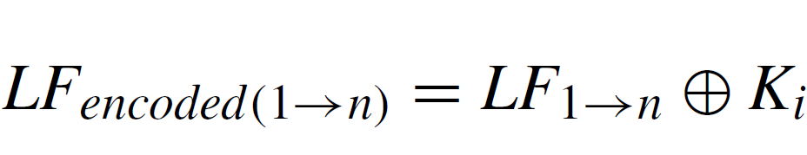
NODE LEVEL (contd..)
Light-Weight Security and Data Provenance for Multi-Hop Internet of Things
Encoded link fingerprint generation
Vernam cipher used
Create copies
  Send one to server
  Save one in node
DEPT OF CSE , MACE KOTHAMANGALAM

Slide 16
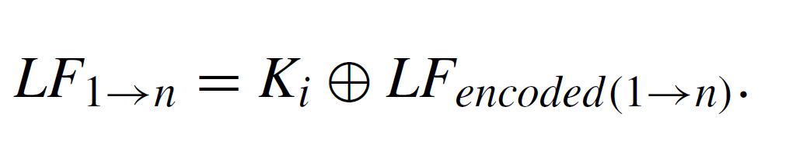
SERVER LEVEL
Light-Weight Security and Data Provenance for Multi-Hop Internet of Things
For one connection: 2 encoded link fingerprints
Decode link fingerprint
Binary to decimal conversion
DEPT OF CSE , MACE KOTHAMANGALAM

Slide 17
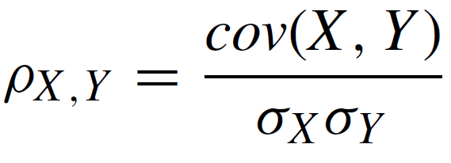
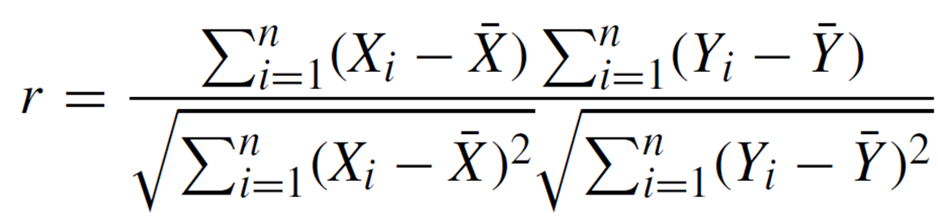
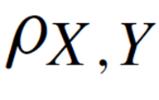
SERVER LEVEL (contd..)
Light-Weight Security and Data Provenance for Multi-Hop Internet of Things
Correlation process
  Compute Pearson correlation coefficient
DEPT OF CSE , MACE KOTHAMANGALAM

Slide 18
SERVER LEVEL (contd..)
Light-Weight Security and Data Provenance for Multi-Hop Internet of Things
Value range : -1 to 1
Condition check
  If value greater than 0.9
    Assumption : No adversarial node
  Else
    Assumption : Adversarial node present
DEPT OF CSE , MACE KOTHAMANGALAM

Slide 19
DATA PROVENANCE
Light-Weight Security and Data Provenance for Multi-Hop Internet of Things
Consider transfer from node 1 to 3 via 2
Usage of packet header
Attachment of link fingerprint
  Beginning and end nodes : 1
  Intermediate nodes : 2
End node sent copy to server
DEPT OF CSE , MACE KOTHAMANGALAM

Slide 20
DATA PROVENANCE (contd..)
Light-Weight Security and Data Provenance for Multi-Hop Internet of Things
Packet header decoded in reverse sequence
Keys at server
Use Pearson correlation coefficient
Cleared as match found
DEPT OF CSE , MACE KOTHAMANGALAM

Slide 21
DATA PROVENANCE (contd..)
Light-Weight Security and Data Provenance for Multi-Hop Internet of Things
Process continue until
  Header data exhausted:
    Assumption : Origin is the last key node
  Mismatch found
    Assumption : Data tampered
DEPT OF CSE , MACE KOTHAMANGALAM

Slide 22
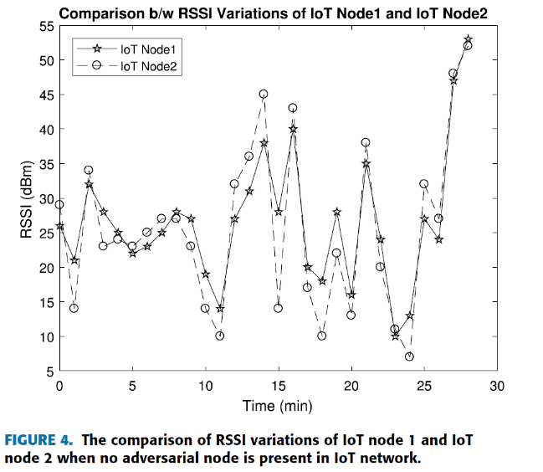
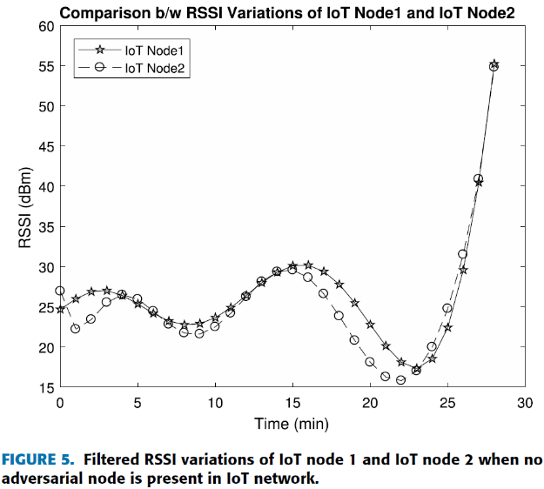
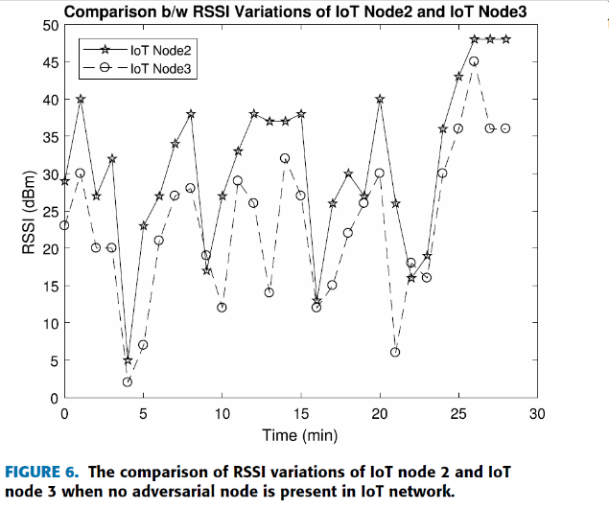
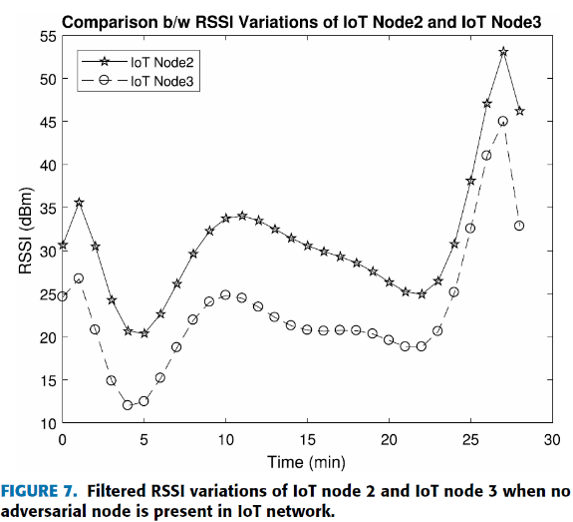
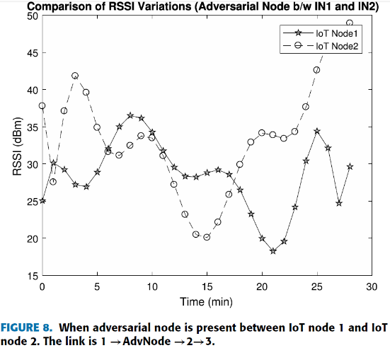
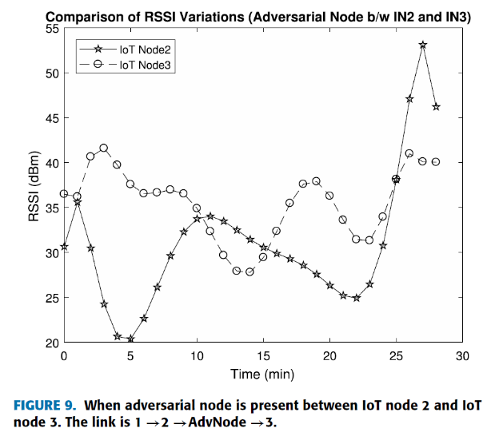
RESULTS
Light-Weight Security and Data Provenance for Multi-Hop Internet of Things
Courtesy : https://ieeexplore.ieee.org/document/8401865
DEPT OF CSE , MACE KOTHAMANGALAM

Slide 23
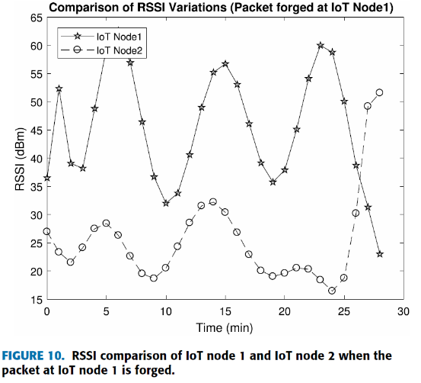
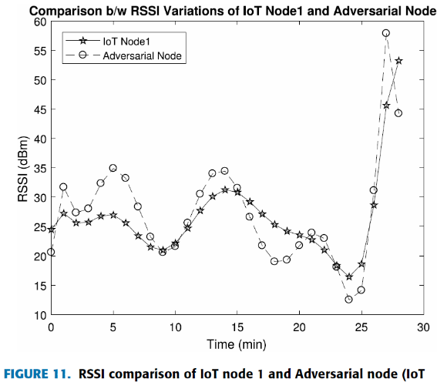

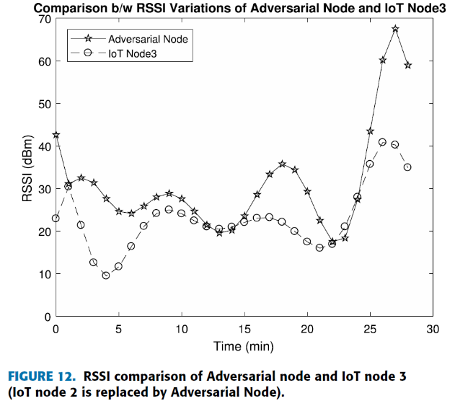
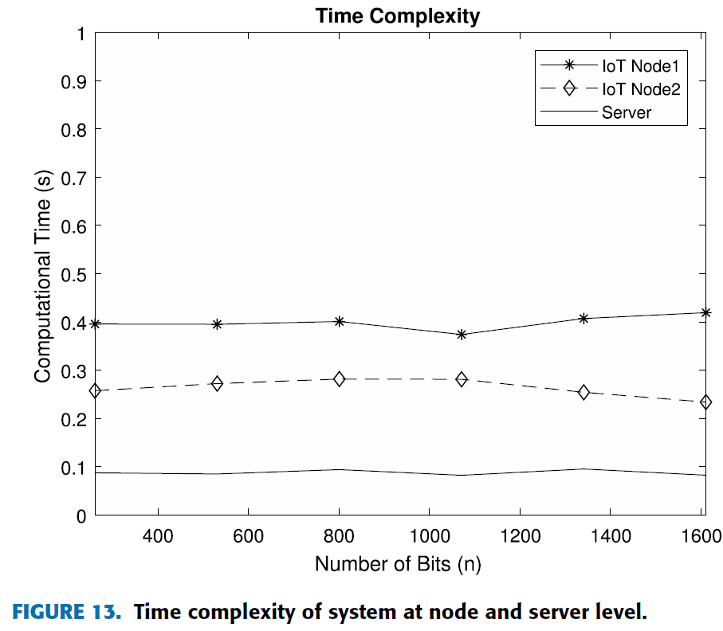
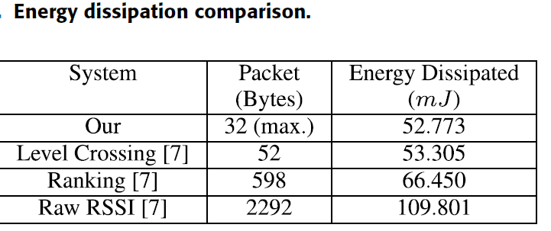
RESULTS (contd..)
Light-Weight Security and Data Provenance for Multi-Hop Internet of Things
Courtesy : https://ieeexplore.ieee.org/document/8401865
DEPT OF CSE , MACE KOTHAMANGALAM

Slide 24
CONCLUSION
Light-Weight Security and Data Provenance for Multi-Hop Internet of Things
Fingerprints generated between connected nodes are highy correlated
Introduction of adversarial node gives very low correlation coefficient
Data origin identified using header
Energy calculations show less energy consumption
Time complexity independent of code length
Light weight solution for security and data provenance
DEPT OF CSE , MACE KOTHAMANGALAM

Slide 25
REFERENCE
Light-Weight Security and Data Provenance for Multi-Hop Internet of Things
[1] Y. Yang, L. Wu, G. Yin, L. Li, and H. Zhao, ``A survey on security and privacy issues in Internet-of-Things,'' IEEE Internet Things J., vol. 4,no. 5, pp. 12501258, Oct. 2017. [Online]. Available: http://ieeexplore.ieee.org/document/7902207/
[2] S. Satpathy, S. Mathew, V. Suresh, and R. Krishnamurthy, ``Ultra-low energy security circuits for iot applications,'' in Proc. IEEE 34th Int. Conf.Comput. Design (ICCD), Oct. 2016, pp. 682685.
[3] M. N. Aman, K. C. Chua, and B. Sikdar, ``Mutual authentication in IoT systems using physical unclonable functions,'' IEEE Internet Things J., vol. 4,no. 5, pp. 13271340, Oct. 2017. [Online]. Available: http://ieeexplore.ieee.org/document/7924368/
[4] T. Idriss, H. Idriss, and M. Bayoumi, ``A puf-based paradigm for IoT security,'' in Proc. IEEE 3rd World Forum Internet Things (WF-IoT),Dec. 2016, pp. 700705.
[5] S.-R. Oh and Y.-G. Kim, ``Security requirements analysis for the IoT,'' in Proc. Int. Conf. Platform Technol. Service (PlatCon), Feb. 2017, pp. 16.
[6] M. I. M. Saad, K. A. Jalil, and M. Manaf, ``Achieving trust in cloud computing using secure data provenance,'' in Proc. IEEE Conf. Open Syst. (ICOS), Oct. 2014, pp. 8488.
[7] S. T. Ali, V. Sivaraman, D. Ostry, G. Tsudik, and S. Jha, ``Securing rst-hop data provenance for bodyworn devices using wireless link ngerprints,'' IEEE Trans. Inf. Forensics Security, vol. 9, no. 12,pp. 21932204, Dec. 2014.
[8] K. Zhang, X. Liang, R. Lu, and X. Shen, ``Sybil attacks and their defenses in the Internet of Things,'' IEEE Internet Things J., vol. 1,no. 5, pp. 372383, Oct. 2014. [Online]. Available: http://ieeexplore.ieee.org/document/6868197/
DEPT OF CSE , MACE KOTHAMANGALAM

Slide 26
REFERENCE (contd..)
Light-Weight Security and Data Provenance for Multi-Hop Internet of Things
[9] G. Kecskemeti, G. Casale, D. N. Jha, J. Lyon, and R. Ranjan, ``Modelling and simulation challenges in Internet of Things,'' IEEE Cloud Com-put., vol. 4, no. 1, pp. 6269, Jan./Feb. 2017. [Online]. Available: http://ieeexplore.ieee.org/document/7879128/
[10] J. Pacheco and S. Hariri, ``IoT security framework for smart Cyber infrastructures,''in Proc. IEEE Int.Workshops Found. Appl. Self Syst., Sep. 2016,pp. 242247.
[11] Z. Bohan, W. Xu, Z. Kaili, and Z. Xueyuan, ``Encryption node design in Internet of Things based on ngerprint features and cc2530,'' in Proc. IEEE Int. Conf. Green Comput. Commun., Internet Things, IEEE Cyber, Phys.Soc. Comput., Aug. 2013, pp. 14541457.
[12] J.-Y. Lee, W.-C. Lin, and Y.-H. Huang, ``A lightweight authentication protocol for Internet of Things,'' in Proc. Int. Symp. Next-Gener. Electron.(ISNE), May 2014, pp. 12.
[13] M. N. Aman, K. C. Chua, and B. Sikdar, ``Secure data provenance for the Internet of Things,'' in Proc. 3rd ACM Int. Workshop IoT Privacy, Trust, Secur., 2017, pp. 1114. [Online]. Available: http://dl.acm.org/citation.cfm?doid=3055245.3055255
[14] J. Qian, H. Xu, and P. Li, ``A novel secure architecture for the Internet of Things,'' in Proc. Int. Conf. Intell. Netw. Collaborative Syst. (INCoS),Sep. 2016, pp. 398401. [Online]. Available: http://ieeexplore.ieee.org/document/7695208/
[15] Y. Xie and D. Wang, ``An item-level access control framework for intersystemsecurity in the Internet of Things,'' Appl. Mech. Mater., vols. 548549, pp. 14301432, Apr. 2014. [Online]. Available: https://www.scientic.net/AMM.548-549.1430
DEPT OF CSE , MACE KOTHAMANGALAM

Slide 27
REFERENCE (contd..)
Light-Weight Security and Data Provenance for Multi-Hop Internet of Things
[16] Q. Wang, D. Chen, N. Zhang, Z. Qin, and Z. Qin, ``LACS: Alightweight label-based access control scheme in IoT-based 5G caching context,'' IEEE Access, vol. 5, pp. 40184027, 2017. [Online]. Available:http://ieeexplore.ieee.org/document/7872420/
[17] Z. Zhou, C. Gao, C. Xu, Y. Zhang, S. Mumtaz, and J. Rodriguez, ``Social big-data-based content dissemination in Internet of vehicles,'' IEEE Trans.Ind. Inform., vol. 14, no. 2, pp. 768777, Feb. 2018. [Online]. Available:http://ieeexplore.ieee.org/document/7995077/
[18] Z. Zhou, K. Ota, M. Dong, and C. Xu, ``Energy-efcient matching for resource allocation in D2D enabled cellular networks,'' IEEE Trans. Veh.Technol., vol. 66, no. 6, pp. 52565268, Jun. 2017. [Online]. Available:http://ieeexplore.ieee.org/document/7585029/
[19] Z. Zhou, H. Yu, C. Xu, Y. Zhang, S. Mumtaz, and J. Rodriguez, ``Dependablecontent distribution in D2D-based cooperative vehicular networks:A big data-integrated coalition game approach,'' IEEE Trans. Intell. Transp. Syst., vol. 19, no. 3, pp. 953964, Mar. 2018. [Online]. Available:http://ieeexplore.ieee.org/document/8264740/
[20] Micaz-Wireless Measurement System, Crossbow Technol., Milpitas, CA,USA, Apr. 2007.
[21] C.-L. Wu and C.-H. Hu, ``Computational complexity theoretical analyses on cryptographic algorithms for computer security application,'' in Proc.IEEE 3rd Int. Conf. Innov. Bio-Inspired Comput. Appl. (IBICA), Sep. 2012, pp. 307311.
DEPT OF CSE , MACE KOTHAMANGALAM

Slide 28
Light-Weight Security and Data Provenance for Multi-Hop Internet of Things
THANK YOU
DEPT OF CSE , MACE KOTHAMANGALAM

